Slide 1
Product Description
It can effectively reduce severity of symptoms associated with neurodegeneration, brain trauma, improve microciculation, increase blood flow, reduce inflammation, etc.

Slide 2
What is Photobiomodulation?
Photobiomodulation (PBM) describes the use of red or near-infrared light to stimulate, heal, regenerate, and protect tissue that has either been injured, is degenerating, or else is at risk of dying. One of the organ systems of the human body that is most necessary to life, and whose optimum functioning is most worried about by humankind in general, is the brain.
The brain suffers from many different disorders that can be classified into three broad groupings: traumatic events (stroke, traumatic brain injury, and global ischemia), degenerative diseases (dementia, Alzheimer's and Parkinson's), and psychiatric disorders (depression, anxiety, post traumatic stress disorder). There is some evidence that all these seemingly diverse conditions can be beneficially affected by applying light to the head. There is even the possibility that PBM could be used for cognitive enhancement in normal healthy people.
810nm near-infrared light can penetrate the scalp and skull.Transcranial leds from the near infrared spectrum have been shown to provide anti-inflammatory and antioxidant effects.Heat shock proteins can also be added to prevent protein misfolding and unwanted synthesis;Has the potential to increase neuron regeneration and synaptic regeneration.

Slide 3
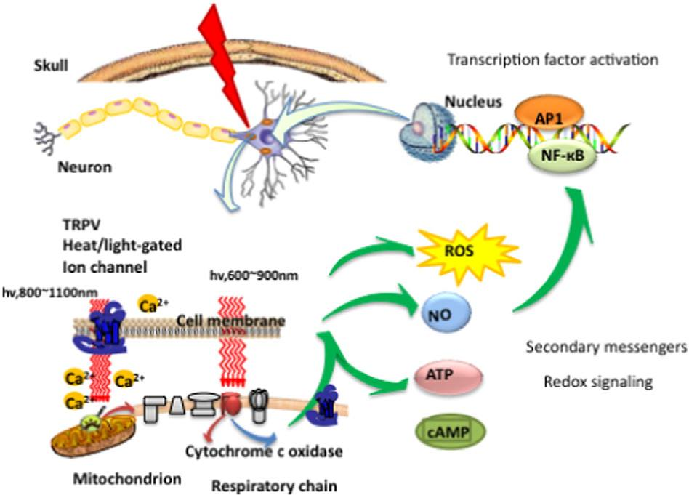
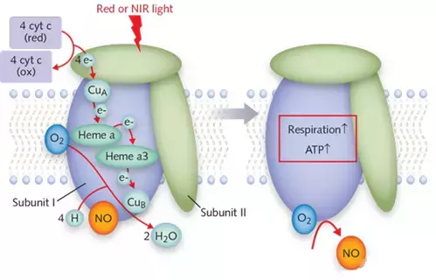
Principle
Cytochrome C oxidase (CCO, also known as complex IV) is a specific structure in mitochondria that ACTS as a photon receptor and thus plays the PBM effect.PBM prevents respiratory inhibition (and correspondingly reduces energy storage) in stress cells by isolating nitric oxide (NO) and reversing the shift of oxygen in cytochrome C oxidase.This triggers transcription factors that alter gene expression levels.The binding of nitric oxide (NO) to copper (or heme) centers in the mitochondrial cytochrome C oxidase (CCO) inhibits cell respiration.But cytochrome C oxidase, which absorbs red or near-infrared (NIR) light, dissociates nitric oxide, restoring oxygen, increasing cellular respiration, and forming adenosine triphosphate (ATP).This triggers a cascade of intracellular reactions involving nitric oxide, reactive oxygen species (ROS), and cyclic adenosine phosphate (cAMP) that produce beneficial effects of PBM.

Slide 4
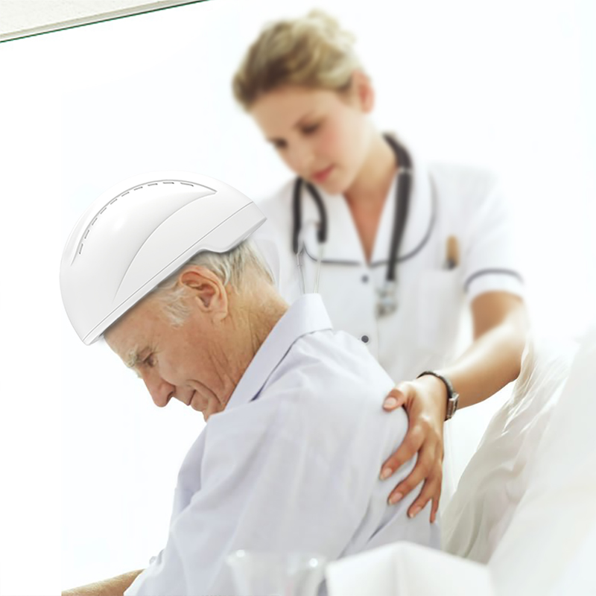
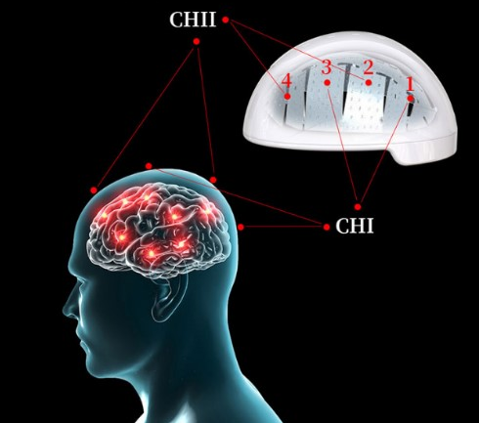
tPBM Mechanisms of Action
• Open heat-gated ion channels to modulate transcription factors
• Enhances neuroprotective proteins and growth factors
• Increases active oxygen content inside the brain
• Promotes cortical production of adenosine triphosphate (ATP)
• Accelerates intracranial blood perfusion and blood born mitochondria

Slide 5
Parameters
Name | Brain Photobiomodulation Helmet
Model | GY-PDT | Wavelength | 1070 nm
Led quantity | 256 pcs | Power (Each LED) | 50 mW
Output power | 15 W | LED frequency | 1-20kHz / 40Hz
Input voltage | 100-240V | Work voltage | 5V-6A
Input current | 800mA | Certificate | CE, FDA
Function | Two channel independently control Time/Power/Frequency adjustable | OEM | support

Slide 6
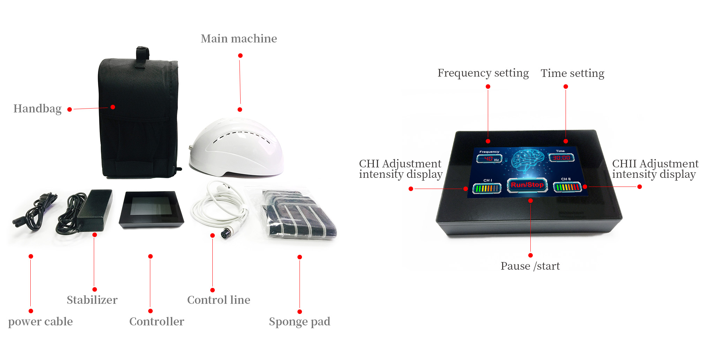
Touch Screen model 1-20k Hz adjustable 0-30minutes adjustable Two channels(0%,25%,50%,100%) of two areas independently control

Slide 7
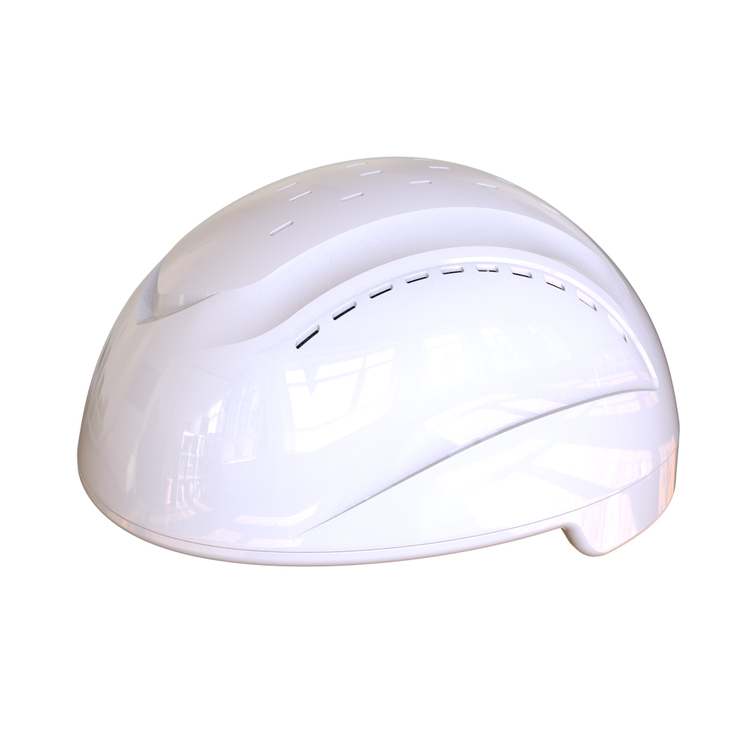
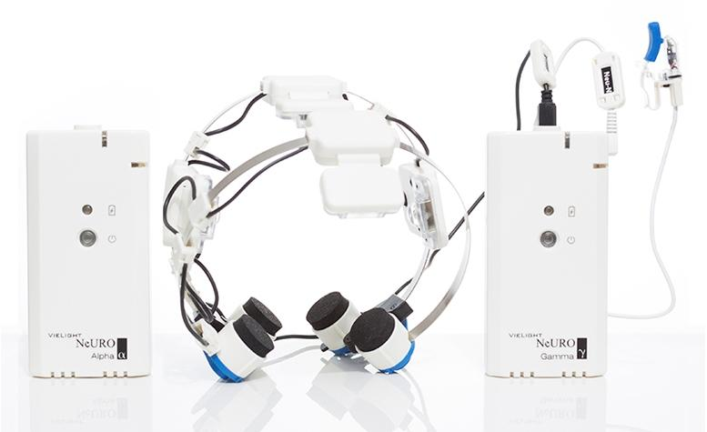
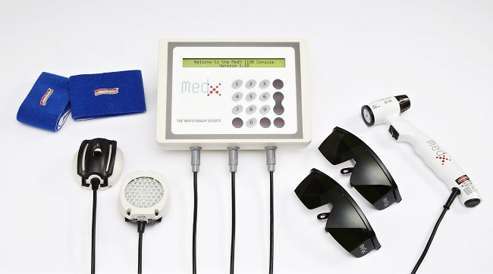
Product Comparison
Name | QMF 1070nm TPBM System | Vielight Neuro PBM Device | (PBM) Console Light System
Picture
Shape | Full head covering | Open-type | Open-type without fixation
LED system | 256 pcs LED, 4 layers FPC | 4 LED modules | 1 LED probe
Frequency | 1-20000 Hz adjustable | preset 10Hz, 40 Hz | preset specific hz
Wavelength | Infrared 810nm | Infrared 810nm | Infrared 870 nm and Visible Red 633nm
Main accessoies | 1 Host helmet machine 1 controller | 1 Transcranial headset 1 Intranasal applicator | 1 console 1 handheld laser
Laser Output | 15W | low power range regulated | 450 mW
Treatment time | 0-30min adjustable | Auto off time 20min | /
Other | Two channel which can control the power(0%,25%,50%,100%) of two areas independently | / | /

Slide 8
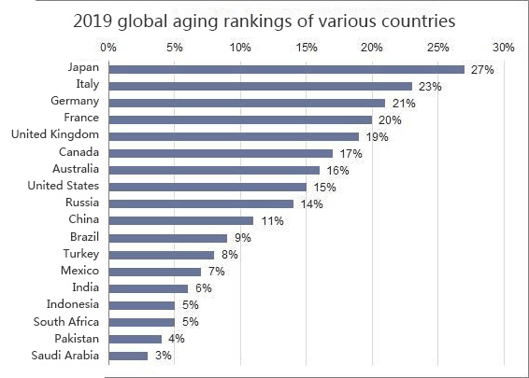
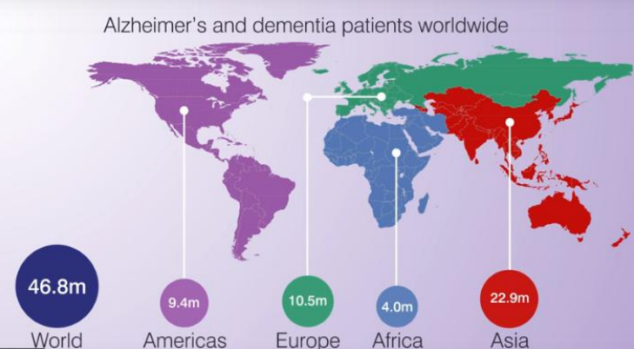
Potential Market
Parkinson's and alzheimer's are the leading brain degenerative diseases in the elderly. Currently, there are more than 46 million Alzheimer's and dementia patients and about 10 million Parkinson's disease patients worldwide.
Add to this those who was suffered from traumatic events (stroke, traumatic brain injury, and global ischemia) and neuropsychiatric disorders (depression, anxiety, post traumatic stress) and neurodevelopmental (autistic spectrum) disorders.
These kind of brain diseases can have a huge impact on a family physically, mentally and financially. The cost of one patient's caregiver per month is very huge, the potential market for this device is tremendous.

Slide 9
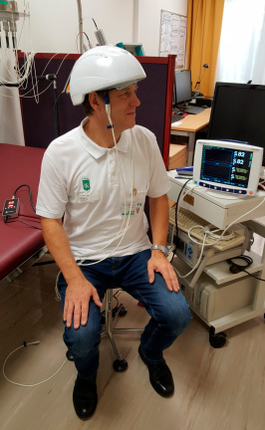
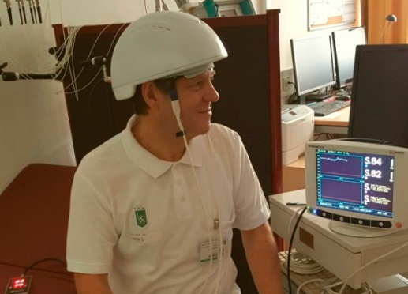
Experiment we do
One of the experiments cooperate with the Complementary and Integrative Laser Medicine, Biomedical Engineering in Anesthesia and Intensive Care Medicine, Medical University.
Showed a clear response of cerebral rSO2 in relation to the our PBM helmet stimulation.
December, 2018

Slide 10
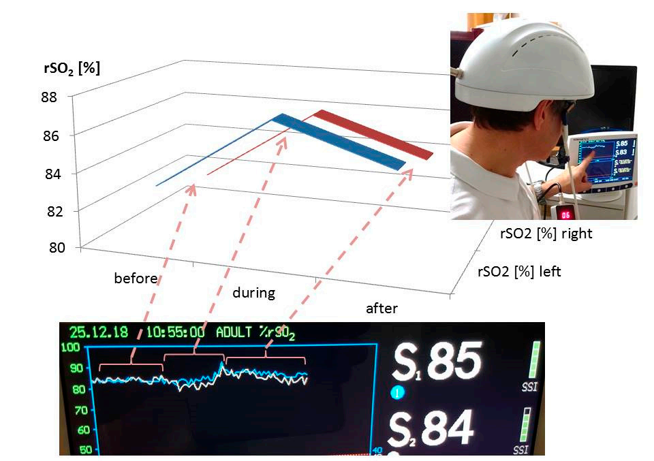
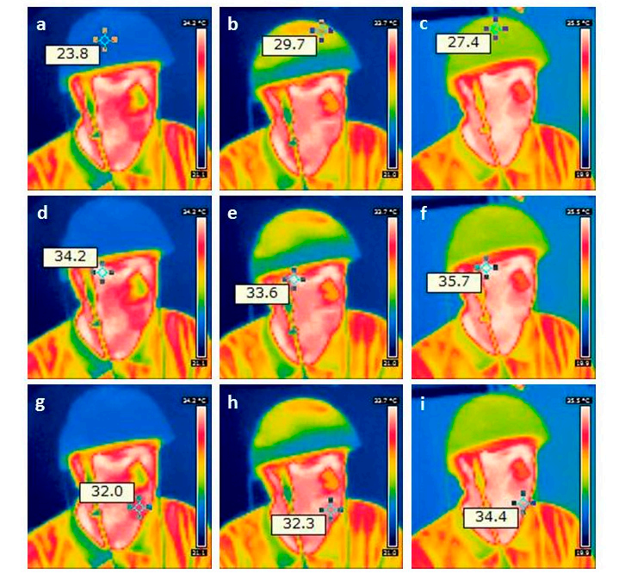
Figure 1:
Results of the increase in the regional cerebral oxygen saturation during and after stimulation on the left and right side.
Figure 2:
Results from thermal imaging of the first pilot measurement using the new stimulation helmet. Note the increase in temperature on the helmet (upper row; a before, b during, and c after stimulation) on the forehead (middle row; d–f) and on the chin (lower row; g–i)

Slide 11
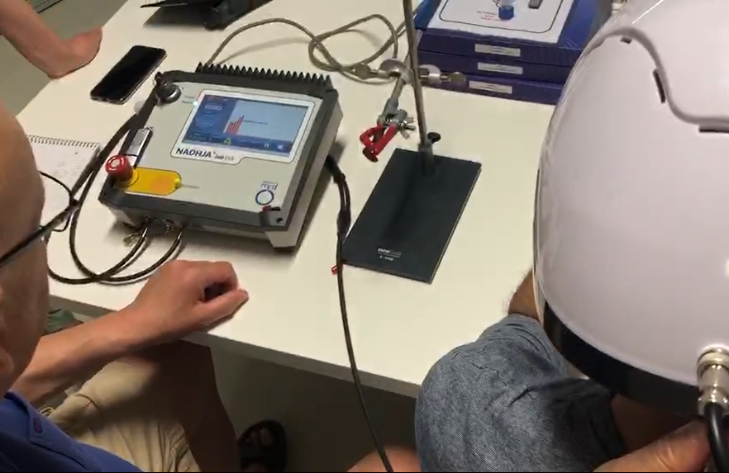
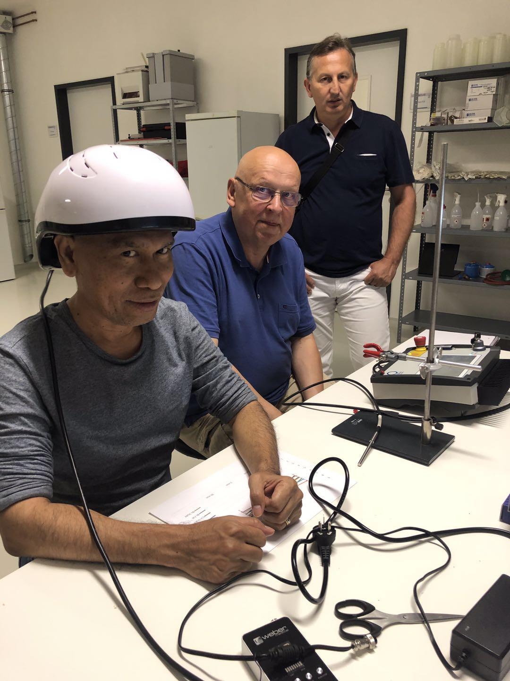
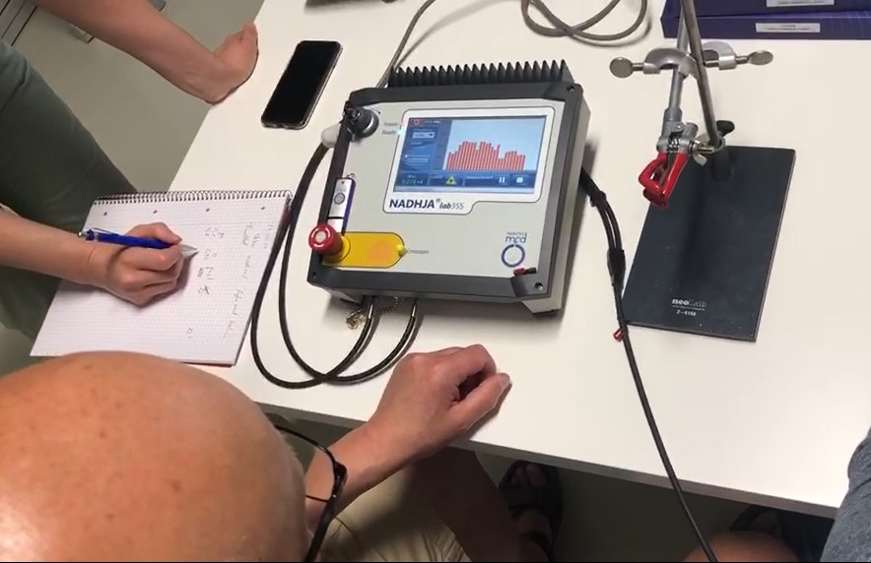
One of the experiments cooperate with the German Healthcare field organization Showed a clear response of NADH reduction, which means the increasing of ATP in relation to our PBM helmet stimulation. May, 2019

Slide 12
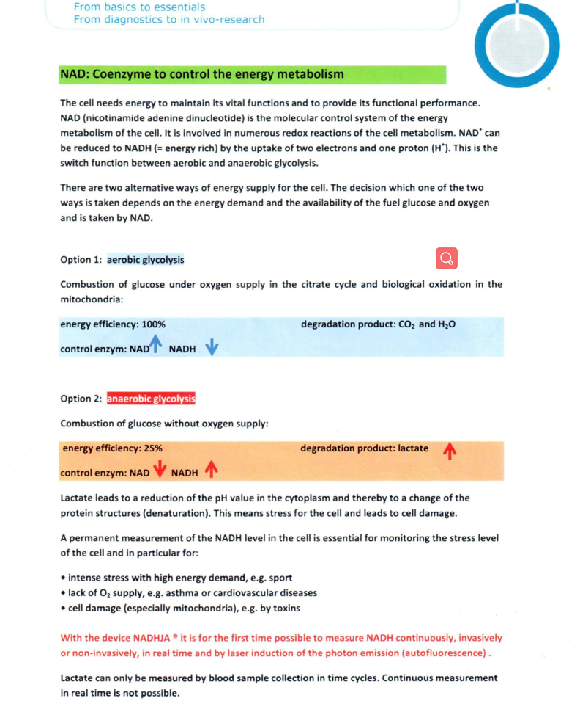
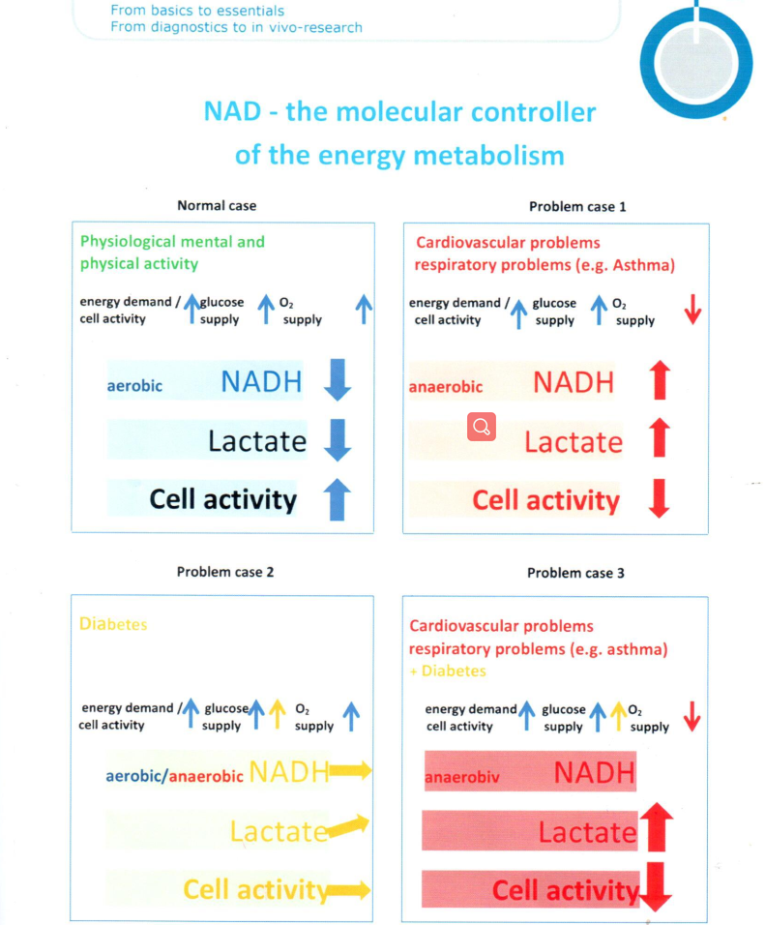

Slide 13
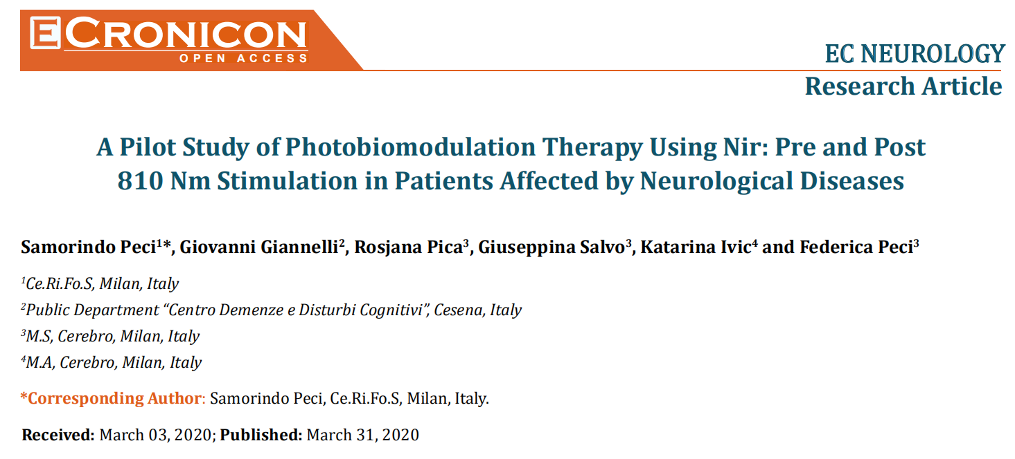
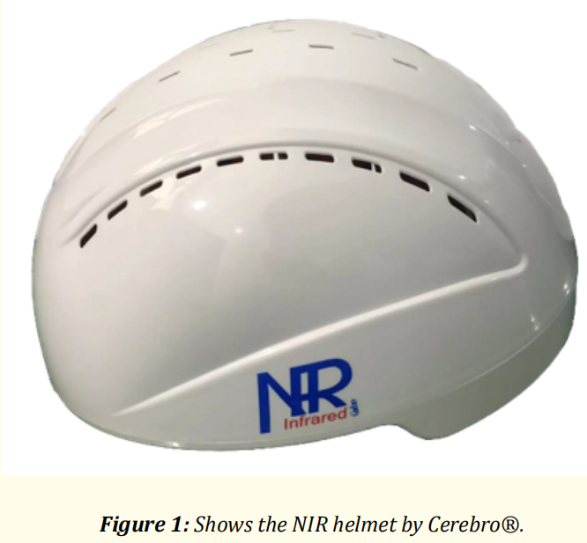
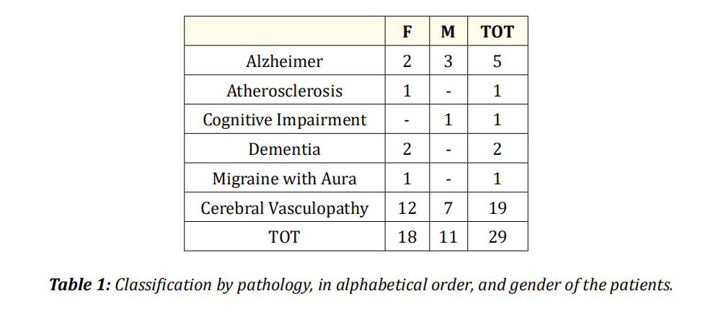
One of the experiments conducted by Italy brain health organization
29 Italian patients underwent NIR stimulation therapy for 1-month, tested before and after
and shown good results March, 2020

Slide 14
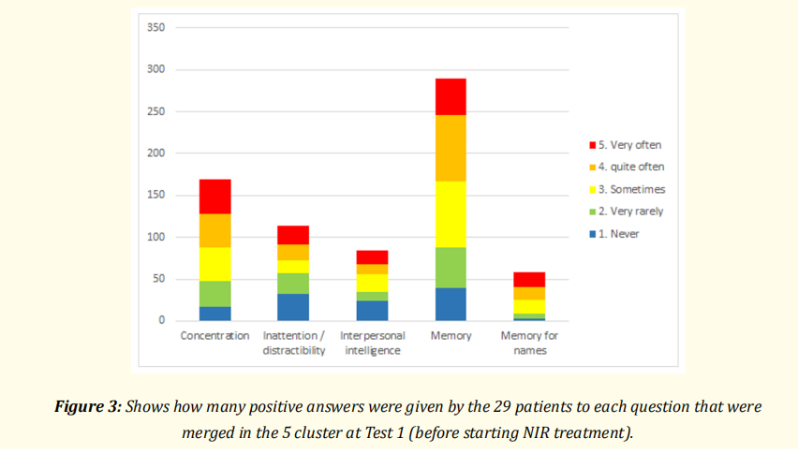
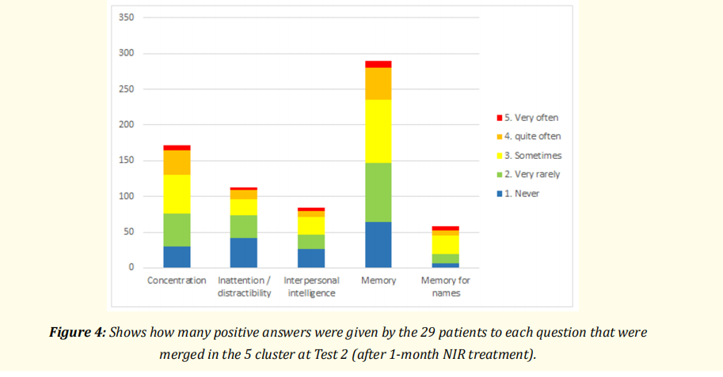
Conclusion:
This kind of wavelengths is described as activating different chromophores at the cortical level promoting the modulation of cellular oxidative stress, neurometabolic and neuroinflammatory processes involved in different neurological disease. Our sample, since it is a pilot study, is small but may start to increase our work with this type of NIR device and proving the effect on everyday life in different diseases. The results from the compilation of the Cognitive Self-Assessment Questionnaire, in two time periods before (Test 1) and after (Test 2) NIR therapy, show a clear improvement in the perception of the symptoms in all the analyzed clusters: concentration, inattention/distraction, interpersonal intelligence and memory.
Specifically, Alzheimer‘s patients noticed a significant improvement in all the questions merged in the clusters with the greatest perceived improvement in the memory cluster. The same level of improved perception is observed by patients with Cerebral Vasculopathy. In patients with Dementia, the improvement is particularly evident in the “concentration” cluster. The other patients not mentioned in the result section due to insufficient sample size, also showed good improvements in all the clusters investigated.

Slide 15
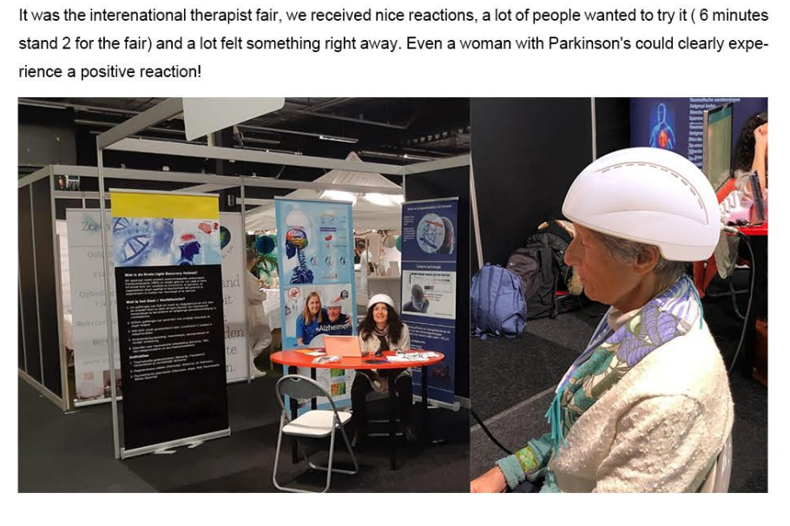
Feedbacks

Slide 16
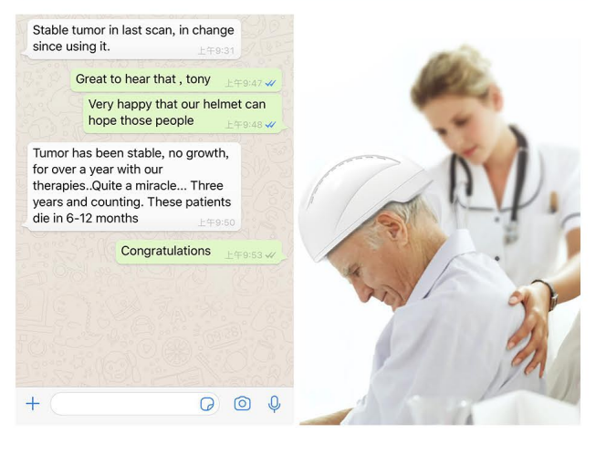

Slide 17
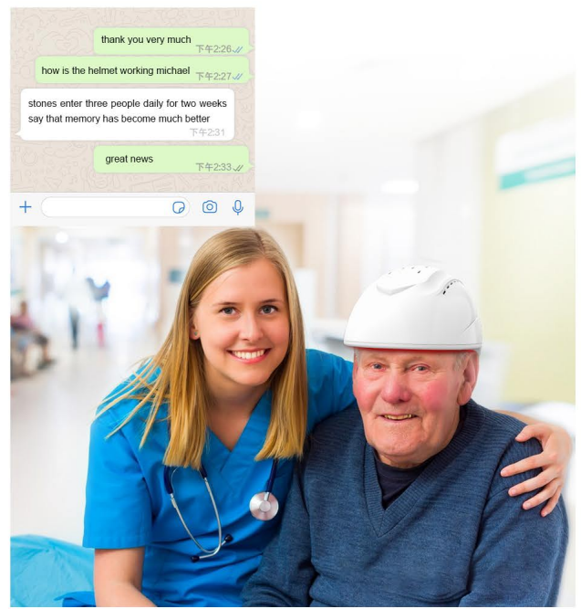
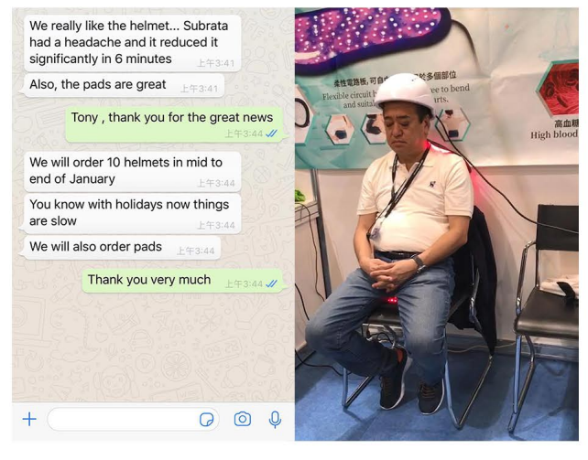

Slide 18
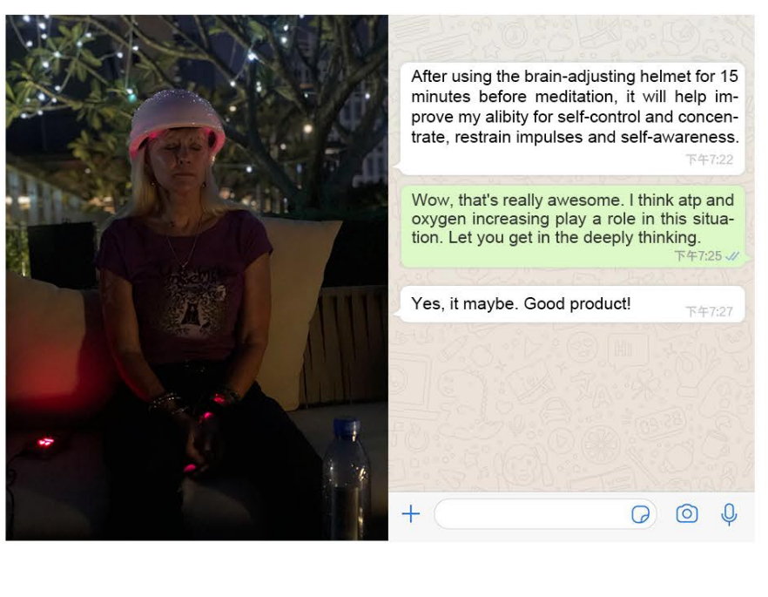

Slide 19
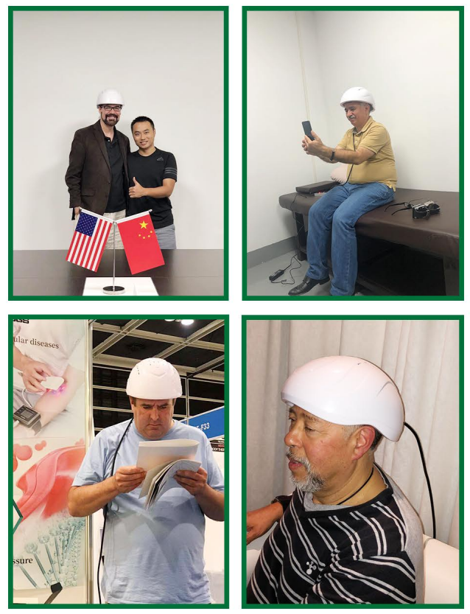
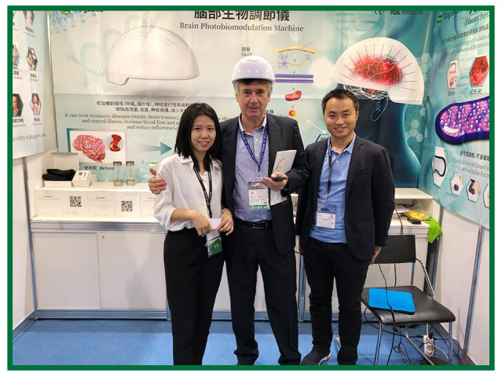

Slide 20
Other Scientific Studies
PBM for Stroke
https://www.ncbi.nlm.nih.gov/pubmed/30983970 https://www.ncbi.nlm.nih.gov/pubmed/29472564 https://www.ncbi.nlm.nih.gov/pubmed/22967677
PBM for Traumatic brain injury
https://www.ncbi.nlm.nih.gov/pubmed/28001756 https://www.ncbi.nlm.nih.gov/pubmed/26990361 https://www.ncbi.nlm.nih.gov/pubmed/25966949
PBM for Psychiatric disorder
https://www.ncbi.nlm.nih.gov/pubmed/22334326 https://www.ncbi.nlm.nih.gov/pubmed/19995444 https://www.ncbi.nlm.nih.gov/pubmed/29307593
PBM for Alzheimer
https://www.ncbi.nlm.nih.gov/pubmed/27815990 https://www.ncbi.nlm.nih.gov/pubmed/28186867 https://www.ncbi.nlm.nih.gov/pubmed/31050950
PBM for Parkinson
https://www.ncbi.nlm.nih.gov/pubmed/25462595 https://www.ncbi.nlm.nih.gov/pubmed/19534794 https://www.ncbi.nlm.nih.gov/pubmed/26484876

Slide 21
To purchase a unit or for more information on 1070nm light therapy call Marvin Berman PhD 610-940-0488 or go to quietmindfdn.org

